Slide 1

PIZZA ORDERING CHATBOT USING AMAZON LEX
Department of Computer Engineering
TERNA ENGINEERING COLLEGE
Nerul (W), Navi Mumbai 400706
CCL MINI PROJECT PRESENTATION
Group Members:
Under the Guidance of : Prof. Reshma Koli
Amey Thakur
Hasan Rizvi
Mega Satish
BE B-50
BE B-51
BE B-58

Slide 2
ABSTRACT
The majority of monotonous jobs that were formerly performed by humans are now replaced by AI. Every firm is aiming to replace the least skilled labour with AI robots that can do comparable tasks more efficiently, especially when it comes to chatbots.
A chatbot is a computer software that mimics human interaction by using voice instructions, text dialogues, or both. Chatbots are being employed to address consumer concerns or problems in food delivery app businesses such as Zomato and Swiggy.
New tools are available now to create and deploy chatbots; Amazon Lex by Amazon Web Services is one of them. This project focuses on creating a Pizza Ordering Chatbot using Amazon Lex to help the user order pizza, where the user can select the type of pizza, the crust, the appetizers.

Slide 3
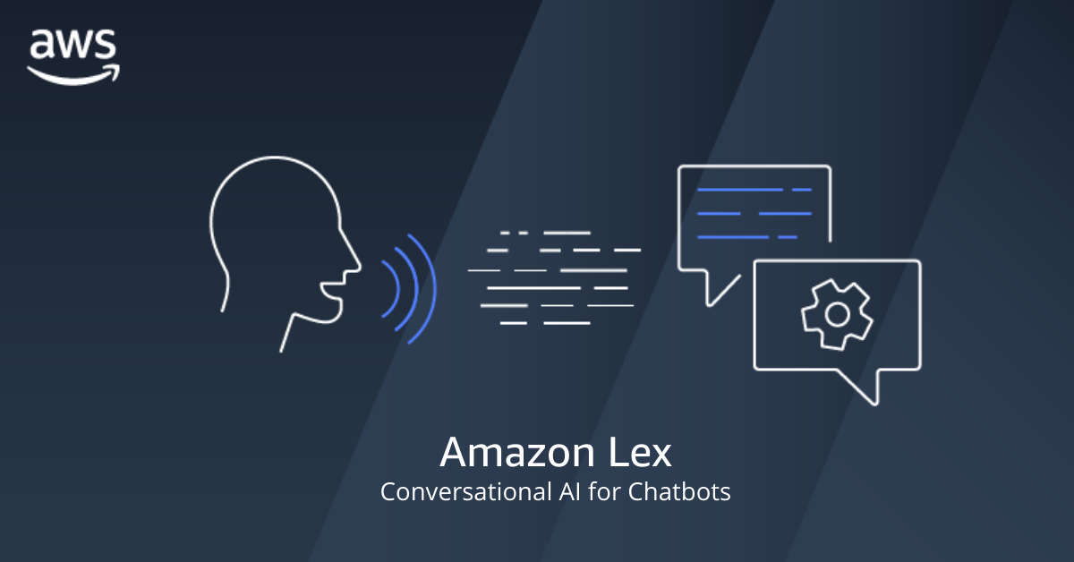
AGENDA
What is a Chatbot?
What is Amazon Lex?
How Lex Works?
Core Concepts & Terminologies
Pizza Ordering Chatbot Demo
References

Slide 4
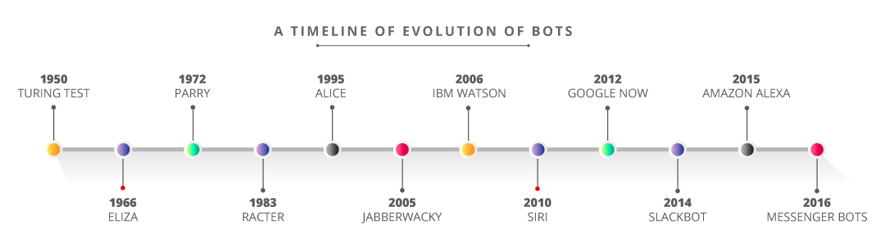
What is a Chatbot?
A chatbot is a computer program which conducts a conversation in natural language via text or speech, understand the intent of the user and sends a response based on business rules and
data of the organization.
Chatbot Applications: Online Shopping, Book Tickets, News Reports, Order Food, Etc.

Slide 5
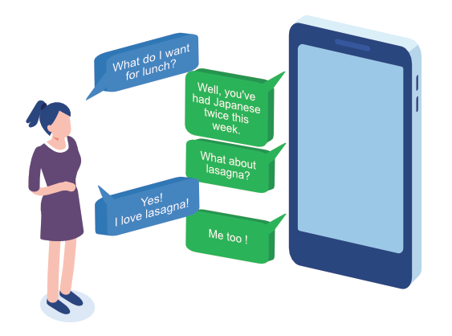
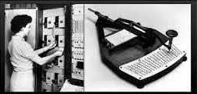
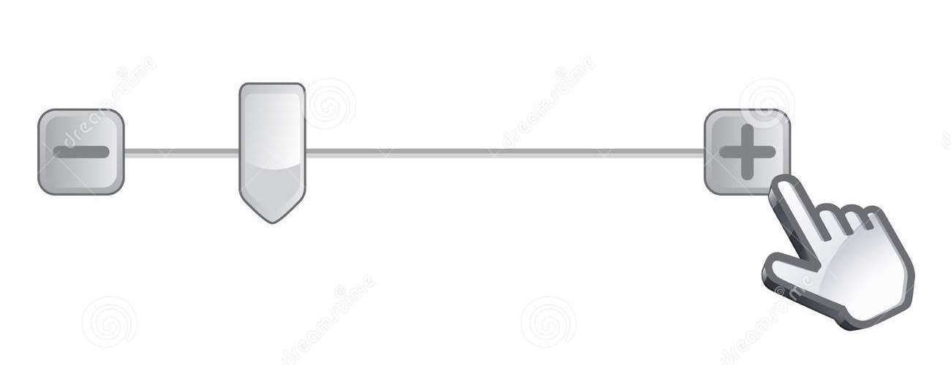
Advent of Conversational Interactions
1st Generation:
Punch card and memory registration
2nd Generation:
Pointers & Sliders
3rd Generation:
Conversational Interface

Slide 6
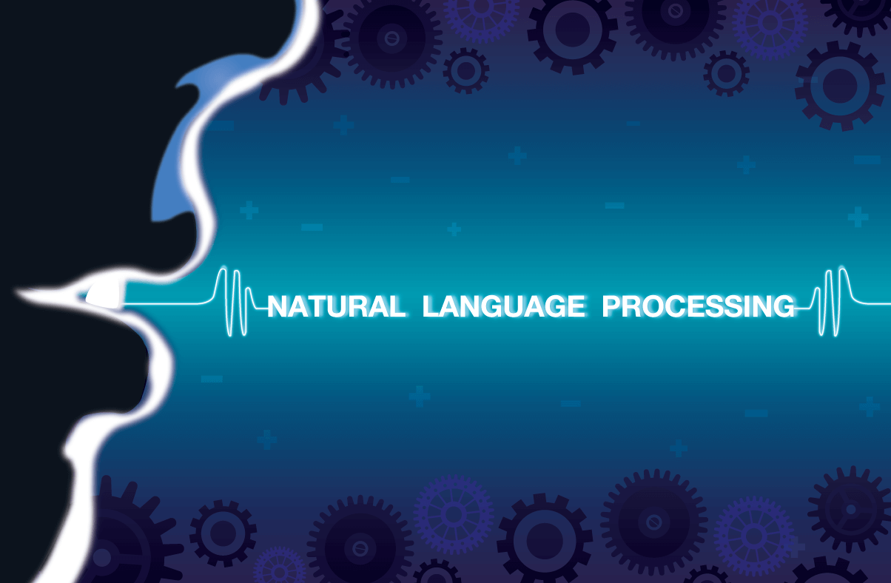
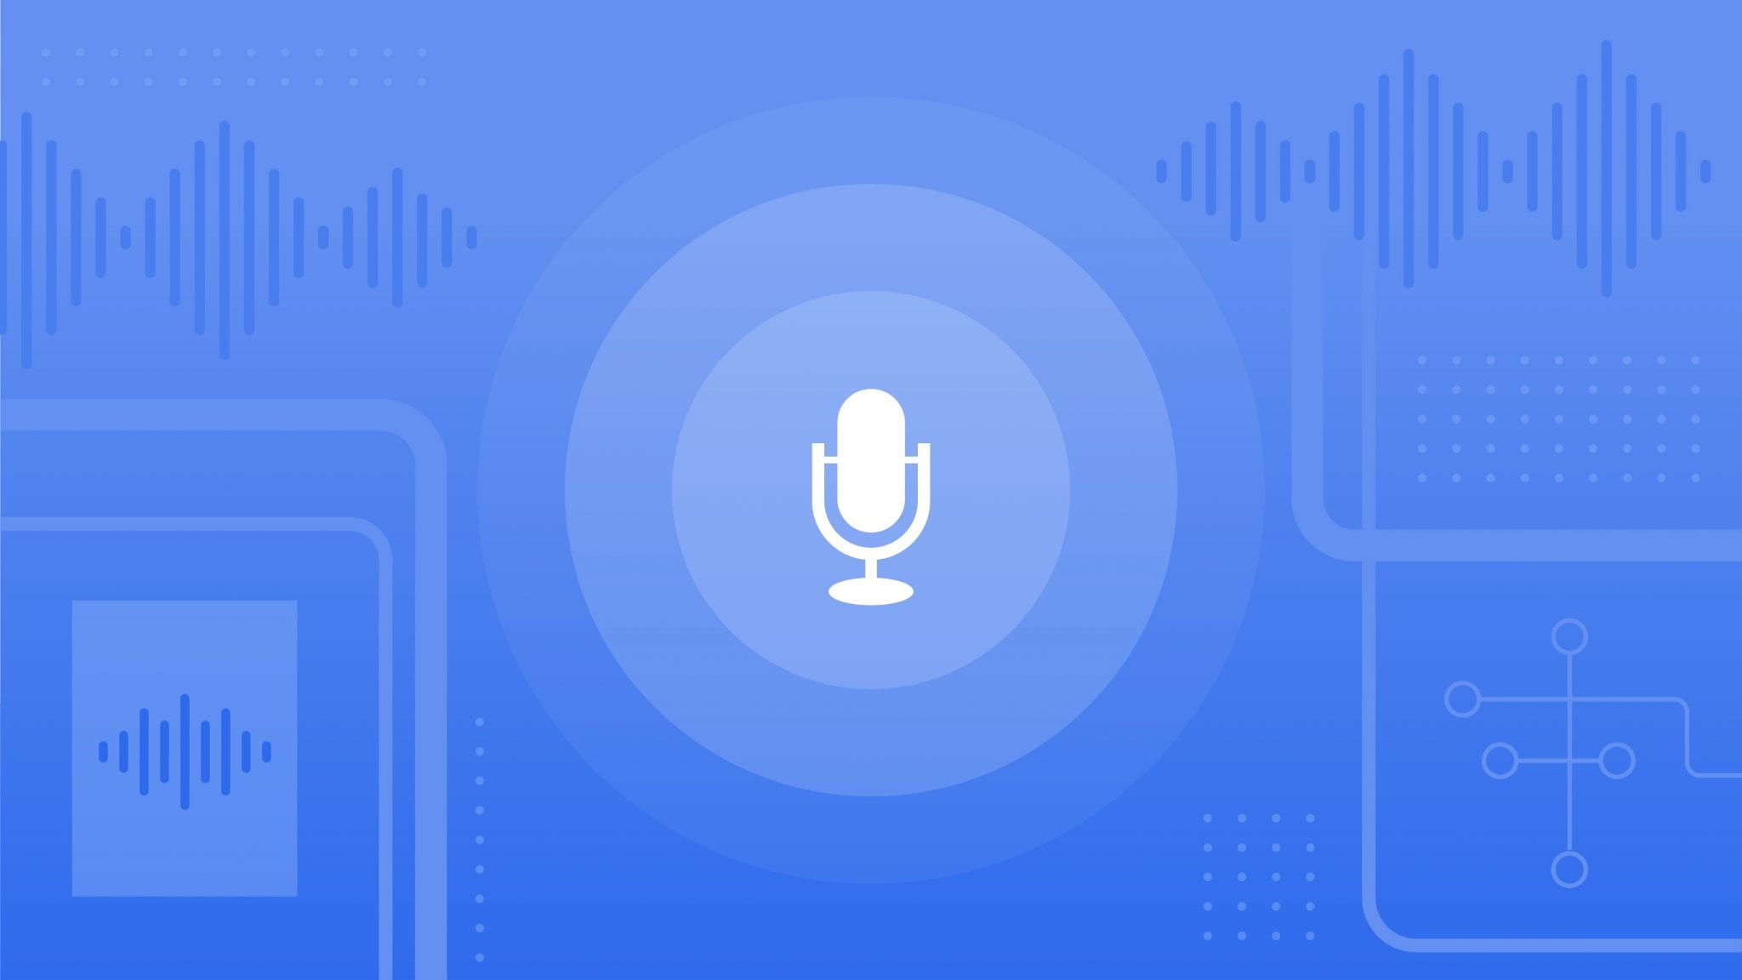
Amazon Lex
Amazon Lex is a service for building conversational interfaces
into any application using voice and text.
NLP
Natural Language Processing
ASR
Automatic Speech Recognition

Slide 7
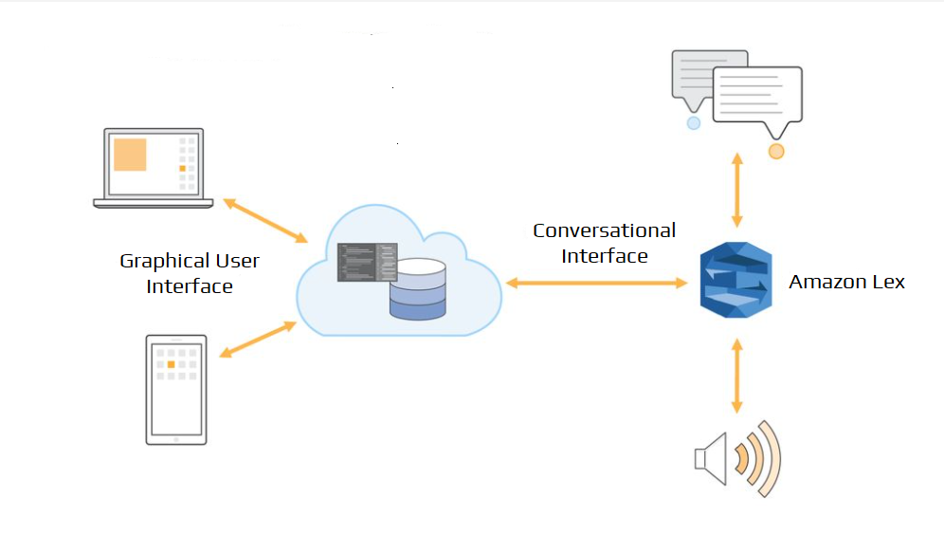
The Need For Amazon Lex

Slide 8
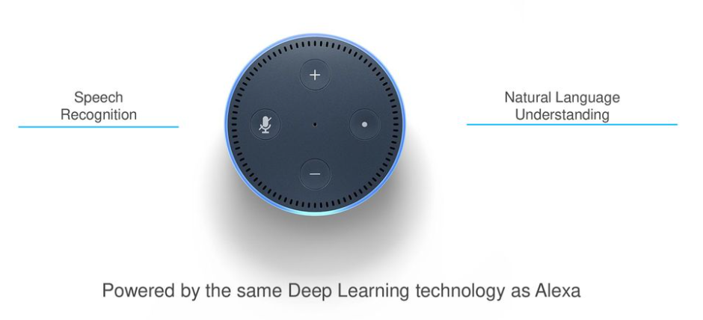
Amazon Lex
Amazon Lex is a powerful conversation framework that allows developers to integrate conversational experiences by embedding voice and text interfaces into new and existing applications.
It is the behind-the-scenes service that powers Alexa.
Amazon Lex is a service for building these conversational user interfaces.

Slide 9
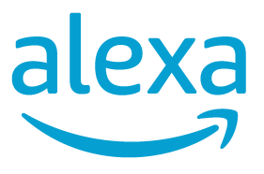
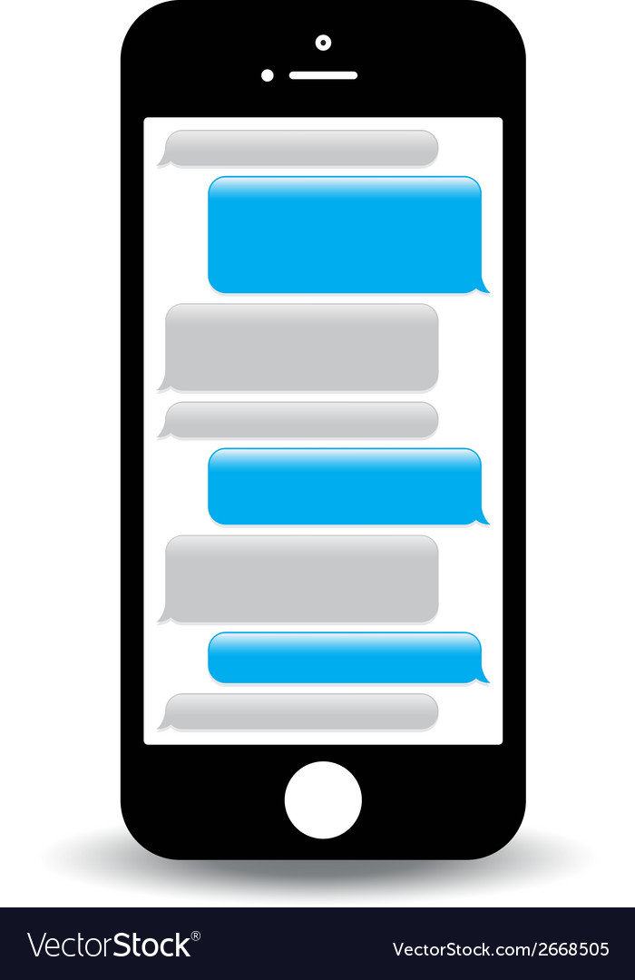



Features of Amazon Lex
Text & Speech language understanding: Powered by the same technology as Alexa
Deployment to chat services
Designed for developers: Efficient and intuitive tools to build and scale automatically
Versioning and alias support
Enterprise SaaS Connectors: Connect to enterprise systems

Slide 10

Benefits of Amazon Lex
Offers an easy to use console & predefined bots.
Employs advanced deep learning functionalities.
Provides seamless deploying & Scaling.
Offers built-in integration with AWS platform.
Cost effective platform to create bots.

Slide 11





Amazon Lex - Use Case (To get banking information through an Amazon Lex chatbot.)
Customer contacts bank for account balance
Amazon DynamoDB
Amazon SNS
Amazon SES
Lex understands user’s request
AWS Lambda requests & retrieves account info
Other AWS Services
Customer is provide with account balance
Lex responds to user in speech, ‘Saving account or current account balance?’
Logs are stored & events are kept track of

Slide 12
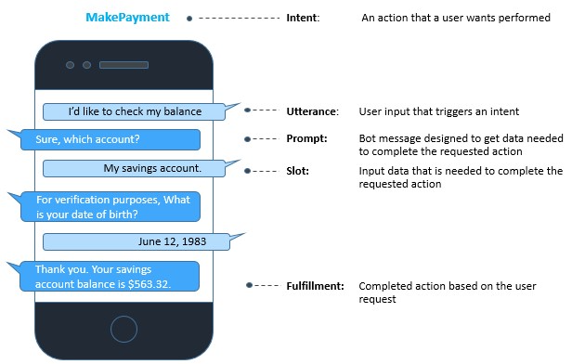
Amazon Lex - Use Case (To get banking information through an Amazon Lex chatbot.)

Slide 13
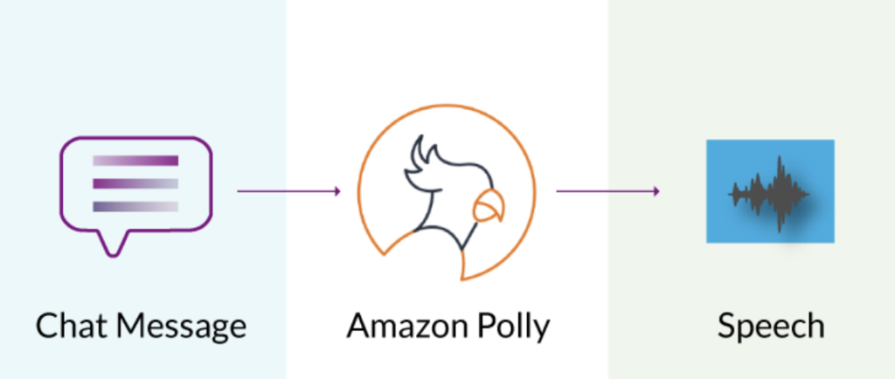
Amazon Polly
Amazon Polly is a service that converts text into natural speech, allowing developers to create applications that talk back to users with a custom voice and build speech-enabled applications and products using Text-to-Speech (TTS) service.
Amazon Polly is offered with over a dozen languages in both male and female voices to help target global audiences.

Slide 14
Amazon Lex - Use Cases
Informational Bots: Chatbots for everyday consumer requests.
Examples: NEWS updates, Weather information, Game scores, etc.
Application Bots: Build powerful interfaces to mobile applications.
Examples: Book tickets, order food, Manage bank accounts, etc.
Enterprise Productivity Bots: Streamline enterprise work activities and improve efficiencies.
Examples: Check sales numbers, Marketing performance, Inventory status, etc.
Internet Of Things (IOT) Bots: Enable conversational interfaces for device interactions.
Examples: Wearables, Appliances, etc.

Slide 15
How Amazon Lex Operates?
Amazon DynamoDB
Amazon SNS
Amazon SES
Other AWS Services
Chatbot receives user input. It can reply with answers, perform actions or ask more input.
Chatbot triggers AWS Lambda. Lambda function performs necessary action by integrating with other AWS services.

Slide 16
Steps to follow while working with Amazon Lex
Create a chatbot & configure it with intents, slots & utterances.
Test the bot on text window slide provided by Lex Console.
Publish a version and create an alias.
Deploy the bot on suitable platform.

Slide 17
Core Concepts & Terminologies
Amazon Bot: An artificial intelligence program that simulates interactive conversation.
Intent: An intent represents an action that user wants to perform.
Slots: Slots are parameters that intent might require.
Slot Types: Every slot has a type. Can create built-in or custom slot types.

Slide 18
Core Concepts & Terminologies
Built a Lambda function to fulfill the intent.
Intent Fulfilment
Client application does necessary fulfillment.
Customises user interaction.
Lambda Functions
As Code Hook
Initiates and Validates user input.
Fulfills user’s intent.

Slide 19
Conclusion
This project focuses on creating a Pizza Ordering Chatbot using Amazon Lex to help the user order pizza, where the user can select the type of pizza, the crust, the appetizers.
Through the proposed system, PizzaOrdering chatbot will efficiently handle the customers and take their order in a simple yet coherent way.
The chatbot carries out the conversation in a pleasant way and is methodically asking for the type of pizza, the pizza crust and appetizers. It additionally ask for the delivery time and ask for confirmation as well.
Using Amazon Lex, we can furthermore enhance the look and the utterances of the chatbot and deploy it on a full scale website using Amazon Cloud Services.

Slide 20

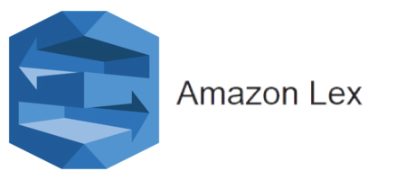
PIZZA ORDERING CHATBOT USING AMAZON LEX
Chatbot Demo

Slide 21


The complete guide to the project
AWS
PROJECT

Slide 22
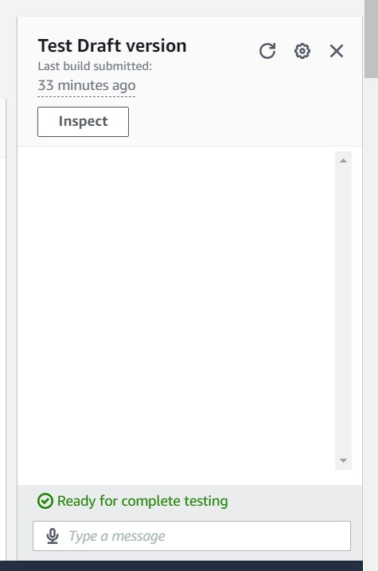
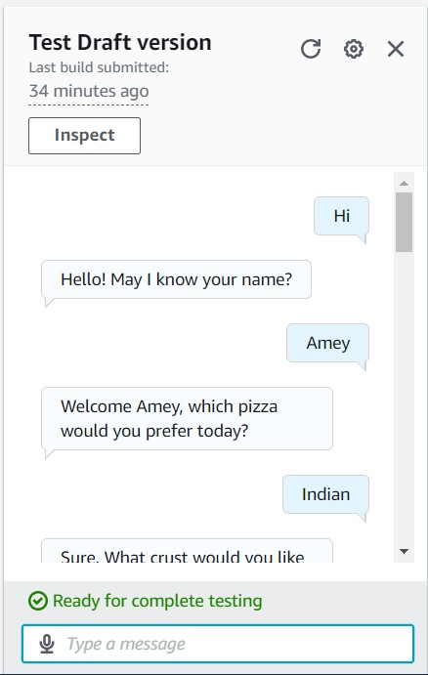
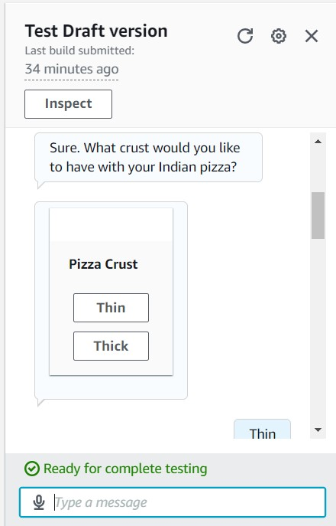
SNAPSHOTS OF OUTPUT
Confirmation of Pizza Order

Slide 23
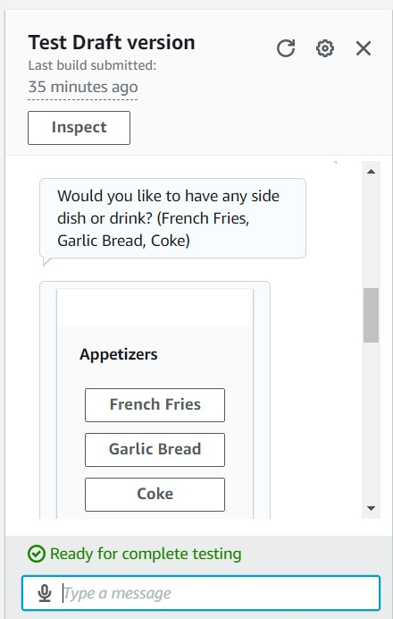
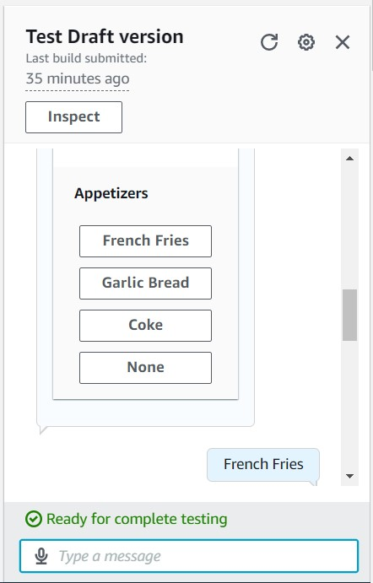
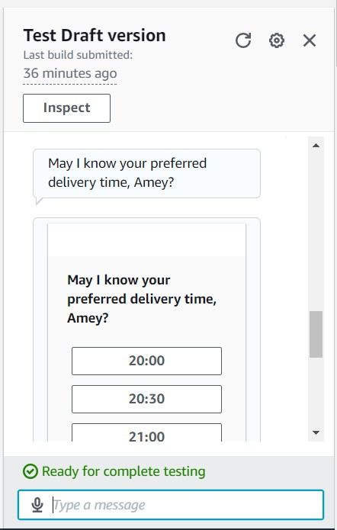
SNAPSHOTS OF OUTPUT

Slide 24
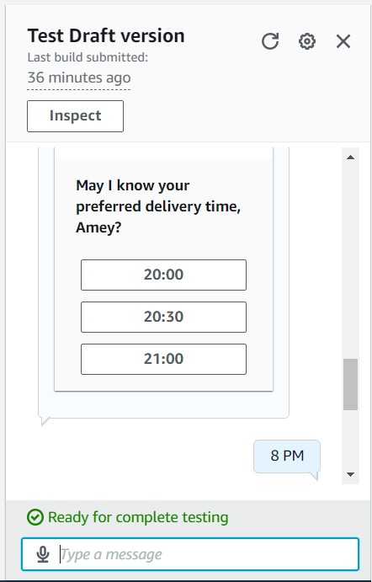
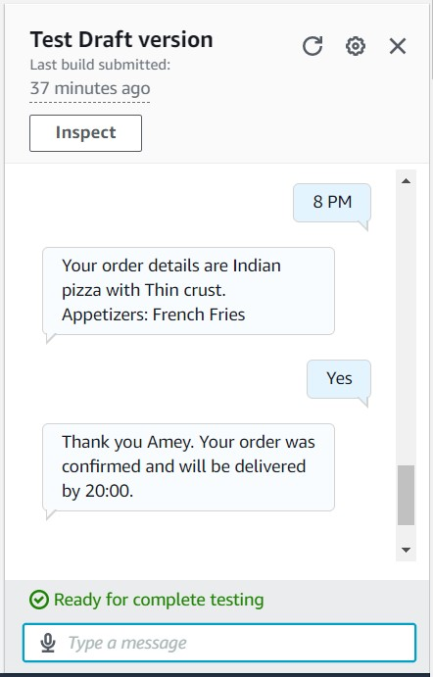
SNAPSHOTS OF OUTPUT

Slide 25
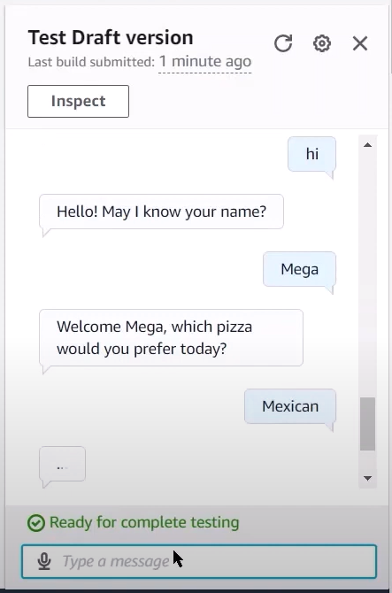
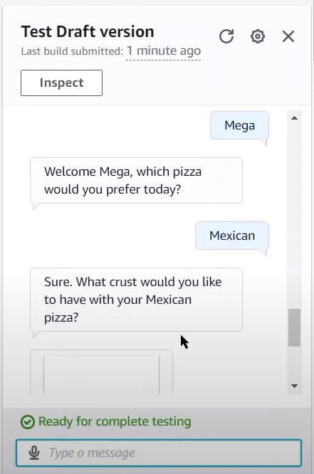
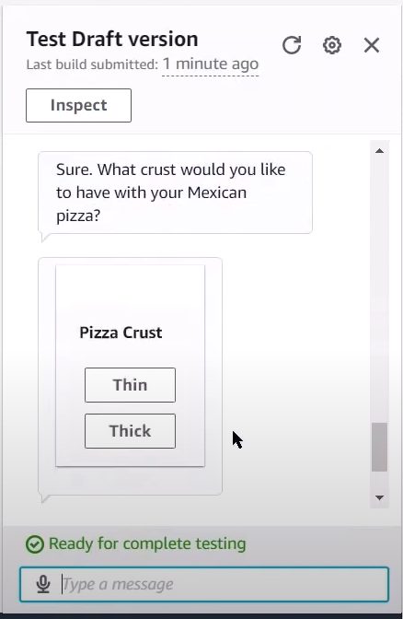
SNAPSHOTS OF OUTPUT
Cancellation of Pizza Order

Slide 26
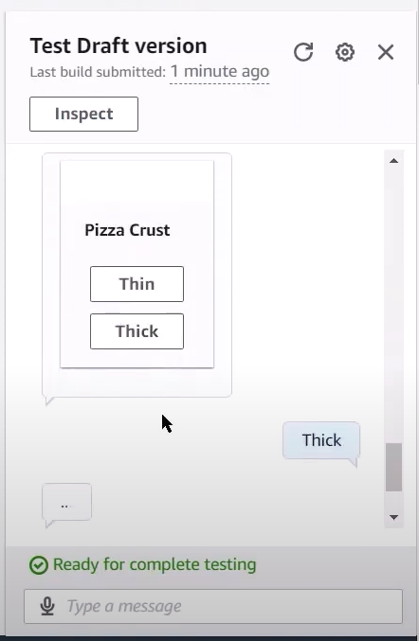
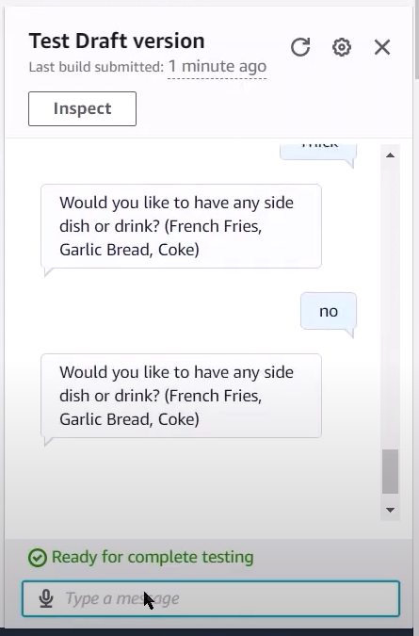
SNAPSHOTS OF OUTPUT

Slide 27
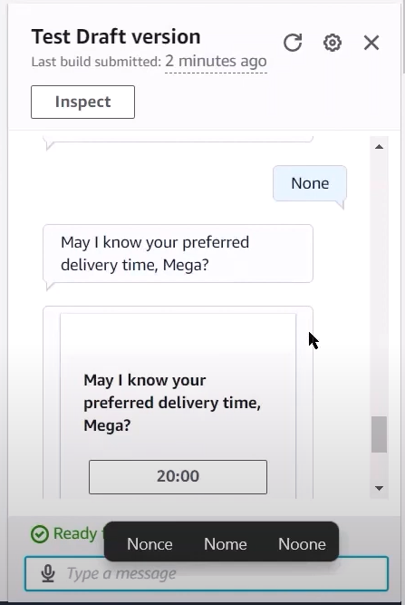
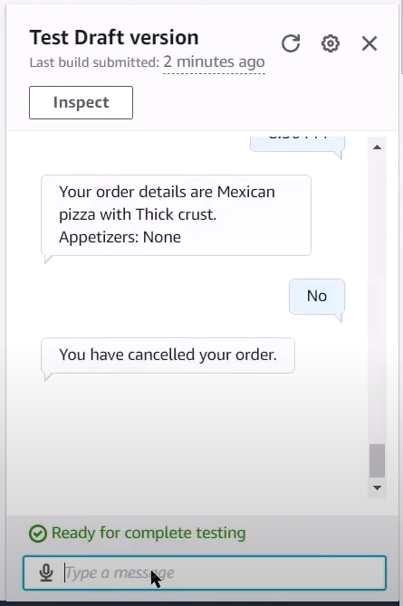
SNAPSHOTS OF OUTPUT

Slide 28
References
Soni, Radhika & Thapar, Radhika. (2019). Acceptance of Chatbots by Millennial Consumers. 10.18231/2454-9150.2018.1343.
https://aws.amazon.com
https://docs.aws.amazon.com
https://aws.amazon.com/lex
https://docs.aws.amazon.com/lex/index.html

Slide 29
THANK YOU

